Slide 1
Configuration of Spring and JPA for development

Slide 2
Configuration

Slide 3
JPA Abstraction Layer
Any Relational Database Dialect
Database
MySQL
Docker

Slide 4
docker-compose.yml
db:
image: mysql:5.7 container_name: conference ports:
- 3306:3306
volumes:
- "./.data/db:/var/lib/mysql" environment:
MYSQL_ROOT_PASSWORD: pass
MYSQL_DATABASE: conference

Slide 5

docker-compose up -d
docker-compose down docker ps
Docker Tips
docker inspect <pid>
docker inspect <pid>| grep “IPAddress"

Slide 6
<dependency>
<groupId>org.springframework.boot</groupId>
<artifactId>spring-boot-starter-data-jpa</artifactId>
</dependency>
Adding Jars with Maven
Version
Transitive Dependencies

Slide 7
persistence.xml
<?xml version="1.0" encoding="UTF-8"?>
<persistence version="2.1" xmlns="http://xmlns.jcp.org/xml/ns/persistence"
xmlns:xsi="http://www.w3.org/2001/XMLSchema-instance" xsi:schemaLocation="http://xmlns.jcp.org/xml/ns/persistence
http://xmlns.jcp.org/xml/ns/persistence/persistence_2_1.xsd">
//…

Slide 8
EntityManagerFactory
EntityManagerFactory entityManagerFactory = Persistence.createEntityManagerFactory("PUNIT"); EntityManager entityManager = entityManagerFactory.createEntityManager(); entityManager.getTransaction().begin();
Registration reg = new Registration("Bob", "Builder", "bobthebuilder@mycompany.com"); entityManager.persist(reg); entityManager.getTransaction().commit(); entityManager.close();
entityManagerFactory.close();

Slide 9
<dependency>
<groupId>mysql</groupId>
<artifactId>mysql-connector-java</artifactId>
</dependency>
Adding MySQL Maven Dependency
Version
Transitive Dependencies

Slide 10
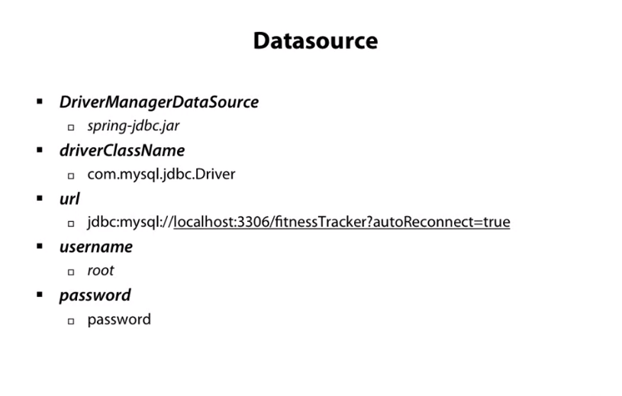

Slide 11
Transactional
@Transactional
public void createRegistration(Registration reg) { registrationRepository.save(reg);
}

Slide 12
logging.level.org.hibernate.SQL=debug
spring.jpa.show-sql=true
spring.jpa.properties.hibernate.format_sql=true
Tips and Tricks
Log Level
Show Queries

Slide 13

Summary
Database
Docker Docker Tips Legacy Added Jars Transactions
Tips and Tricks

